Slide 1
sql projects on moiveReservation

Slide 2
introdcution
The Movie Reservation System is a database project designed to manage and streamline the process of booking movie tickets for users. This project simulates a real-world cinema reservation system using SQL for data storage, management, and retrieval.
users to browse available movies, check showtimes, select seats, and reserve tickets. From an administrative perspective, it provides functionality to manage movie schedules, theater halls, seating arrangements, and customer bookings.
The primary goal of the project is to demonstrate how relational databases can be used to efficiently manage complex operations in a movie theater environment. This project covers database design (ER diagrams, normalization), SQL queries (CRUD operations), and data integrity through the use of constraints and relationships between multiple tables such as Movies, Theaters, Showtimes, Seats, Reservations, and Users.

Slide 3
Objectives
To Design a Relational Database Schema
To Implement CRUD Operations Using SQL
To Simulate a Real-Time Movie Ticket Booking Process
To Maintain Data Integrity and Consistency
To Provide Admin Control Over Movie and Show Management
To Prevent Double Booking or Overbooking
To Enhance Understanding of Real-World Database Applications

Slide 4
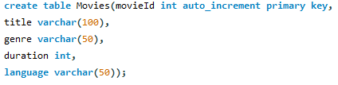
Table1:Movies(TO store the movie details)

Slide 5

Table2:Theaters(TO store the theaters details)

Slide 6
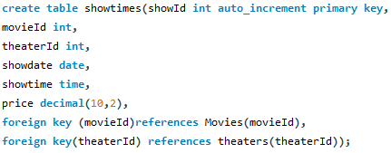
Table3:Showtimes

Slide 7

Table4:customers(TO store the customer details)

Slide 8
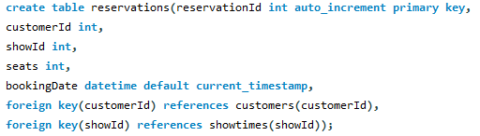
Table5:reservations(TO store the reservation details)

Slide 9
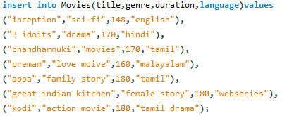
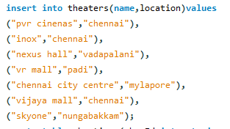
Sql queris:Insert Table Values for movies,theaters

Slide 10
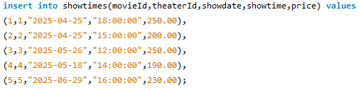
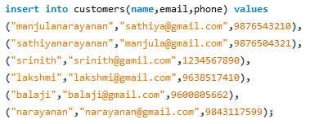
Sql queris:Insert Table Values for showtimes,customers

Slide 11
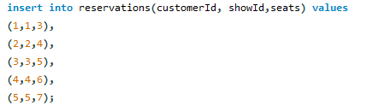
Sql queries:Insert Table Values for reservations

Slide 12
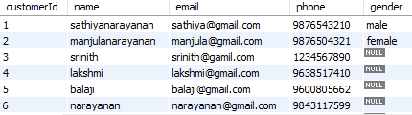
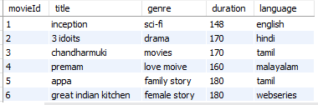
Table Values for movies,customers

Slide 13
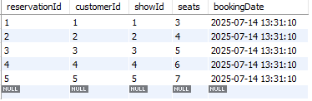
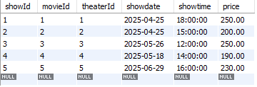
Table Values for showtime,reservations

Slide 14
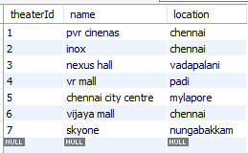
Table Values for theater

Slide 15

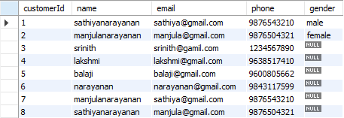
Alter and update Table name from customers

Slide 16
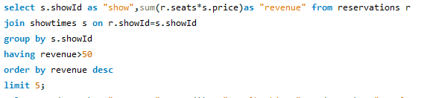
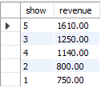
Find revenue value for reservations in descending order

Slide 17

Find totalbooking and totalseats for reservations

Slide 18
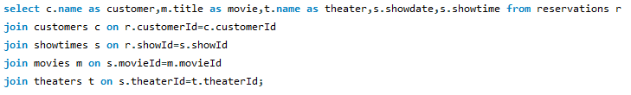
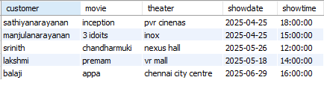
using joins we can join all the table from moivereservation database

Slide 19

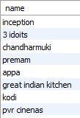
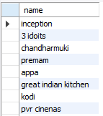
using union and union all

Slide 20
adavantages
Simulates a real business scenario: managing movies, showtimes, bookings, customers, etc.
SQL enforces data validation rules, constraints, and relationships (like foreign keys), ensuring:No double-booking of seats,Users can't reserve non-existent shows,Correct handling of available seats
SQL makes it easy to store, retrieve, update, and delete reservation-related data.
Can handle large volumes of users and bookings efficiently.
Generate reports like:Most booked movies,Occupancy rates,customer booking history
Use SQL queries for analytics or business insights.
SQL allows multiple users to book tickets simultaneously while avoiding conflicts or double-booking.
SQL databases support user roles, permissions, and authentication, helping protect sensitive user data and booking info.
Easily connects with web/mobile applications through APIs or backend services to allow real-time booking functionality.

Slide 21
conclusion
The movie reservation system using SQL demonstrates the practical use of relational databases in real-world applications. SQL, the project ensures accurate, secure, and efficient handling of essential data such as movies, showtimes, customers, and bookings.
This project showcases how structured query language can be used to:
Manage large volumes of reservation data,
Maintain data consistency and integrity,
Support real-time seat availability and customer interactions.
It also provides a strong foundation in database design, including the use of ER diagrams, normalization, relationships, and complex SQL queries for reporting and analysis.
In summary, the movie reservation project not only highlights the capabilities of SQL in building a reliable and scalable booking system but also reinforces key database concepts essential for both academic and professional development.

Slide 22
Thank you

